Slide 1
Sybil-proof Accounting Mechanisms in P2P Networks
Alexander Stannat
Master Student
Applied Mathematics

Slide 2
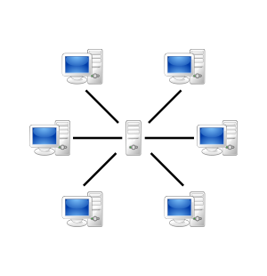
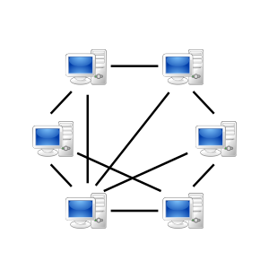
P2P Networks

Slide 3

P2P File-sharing
Agents up- and download files amongst one another
Each file is split into smaller pieces
Nodes that require a particular file join a swarm of other nodes with the same needed file organised as a random mesh
Nodes know about pieces obtained by their neighbours
Nodes request desired pieces from their neighbours
Pieces aren‘t downloaded in sequential order

Slide 4
File Distribution in a Swarm

Slide 5
P2P Networks
Pros
No single point of failure (More robust, no DDoS)
No congestion
No expensive server architecture needed
More efficient
Cons
No Accountability
Spyware (source is often not trustworthy)
No backup of data and no proper management
Updates are more difficult to do

Slide 6

Tribler
P2P File-sharing network based on BitTorrent client
Blockchain based (Trustchain)
Open source
Anonymous (Based on Onion Routing)
Overlay Network for Content Searching (Independent of external websites for content discovery)
No central tracker necessary
Decentralised
„The only way to take Tribler down is to take down the internet“ – Johan Pouwelse (2009)

Slide 7
Problem
It is beneficial to consume data, but not to contribute to others
Tragedy of the commons
Some agents may decide to only consume data (lazy freeriding)
How can we incentivise cooperation?
Reciprocity! Collaborators need to be rewarded

Slide 8
Current solution
BitTorrent uses a mechanism of direct reciprocity: Tit-for-Tat
A seeding peer (A) chooses 5 downloaders
4 with the highest upload rates to A
1 randomly chosen (optimistic unchoking)
If node B doesn‘t contribute to A, A „chokes“ out B
Node B can then only hope to be optimistically unchoked again (low probability, download much slower)

Slide 9
Problem with Direct Reciprocity
In Tribler interactions are often asymmetric and fleeting
Direct Reciprocity: Tit-for-tat
Relies on repeated encounters between the same people
Prisoner’s Dilemma
Defecting more beneficial than cooperation when swarms become too big
We need to expand our mechanism beyond bilateral relationships.
Accounting Mechanisms

Slide 10
Implementing an Accounting Mechanism in a Distributed System
Design Goal: An algorithm, ranking agents based on their history of cooperation in the network
Intuition: Use graph theoretical centrality measures on the „work graph“

Slide 11

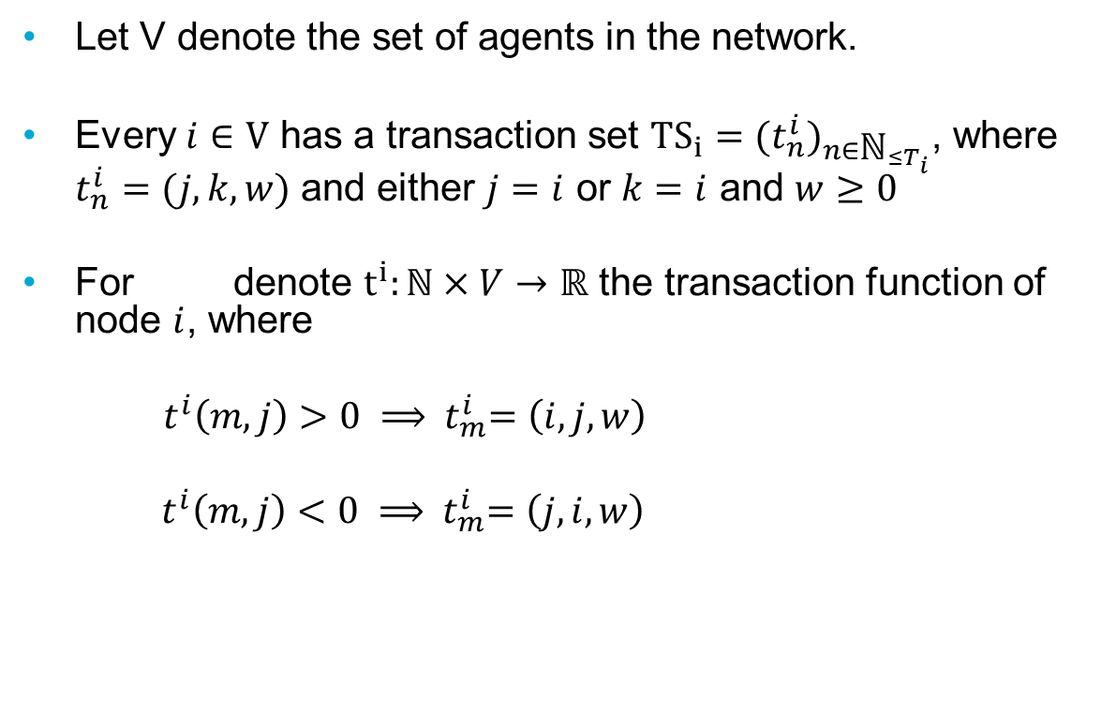
Work Graph
Let V denote the set of agents in the network.
Every $i∈V$ has a transaction set ${TS}_{i}={{(t}_{n}^{i})}_{n∈{\text{ℕ}}_{≤T_{i}}}$, where $t_{n}^{i}=(j,k,w)$ and either $j=i$ or $k=i$ and $w≥0$
For denote $t^{i}:\text{ℕ}×V→ℝ$ the transaction function of node $i$, where
$t^{i}\left(m,j\right)>0 ⟹{ t}_{m}^{i}=\left(i,j,w\right)$
${ t}^{i}\left(m,j\right)<0 ⟹{ t}_{m}^{i}=\left(j,i,w\right)$
$$i∈V$$

Slide 12
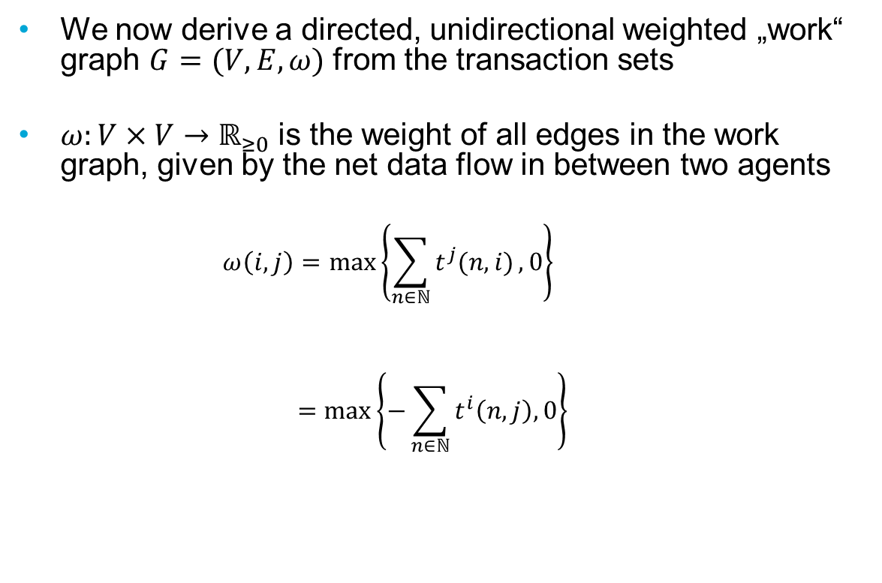
Work Graph
We now derive a directed, unidirectional weighted „work“ graph $G=(V,E,ω)$ from the transaction sets
$ω:V×V→ℝ_{≥0}$ is the weight of all edges in the work graph, given by the net data flow in between two agents
$$ω\left(i,j\right)=max\left\{\sum_{n∈ℕ}{t^{j}(n,i)},0\right\}$$
$$=max\left\{−\sum_{n∈ℕ}{t^{i}\left(n,j\right),0}\right\}$$

Slide 13
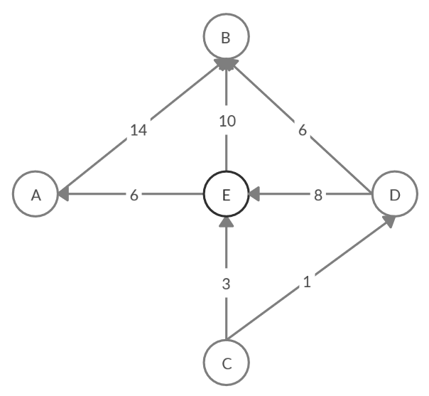
Example Work Graph

Slide 14
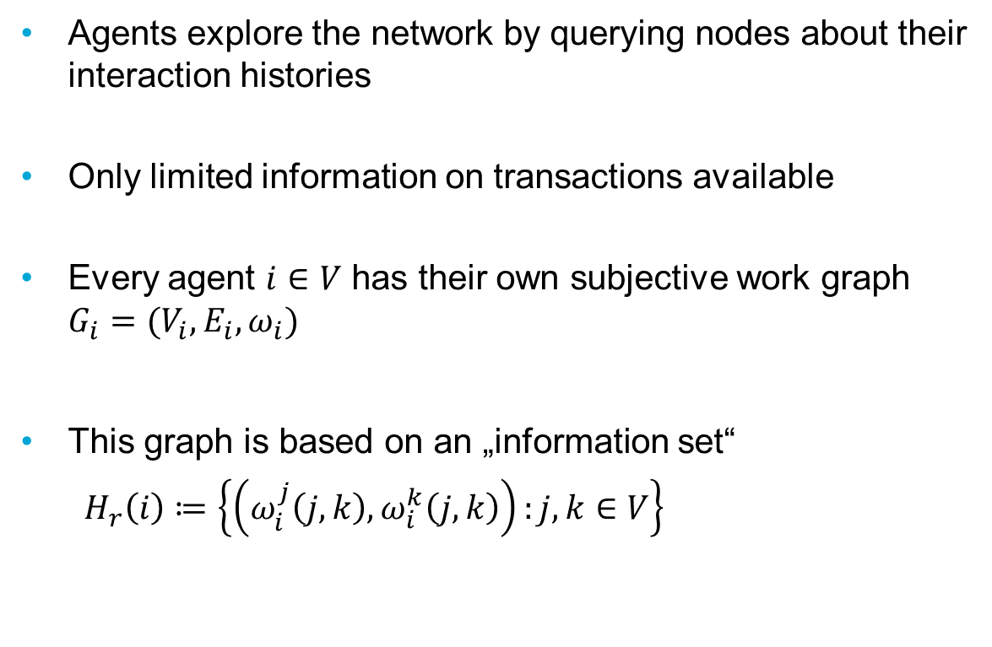
Subjective Work Graph
Agents explore the network by querying nodes about their interaction histories
Only limited information on transactions available
Every agent $i∈V$ has their own subjective work graph $G_{i}=(V_{i},E_{i},ω_{i})$
This graph is based on an „information set“
$H_{r}\left(i\right)≔\left\{\left(ω_{i}^{j}\left(j,k\right),ω_{i}^{k}\left(j,k\right)\right):j,k∈V\right\}$

Slide 15
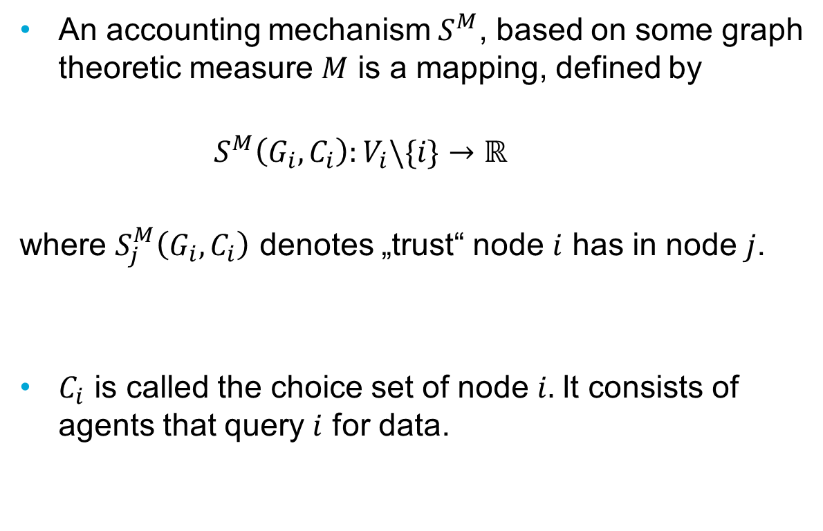
Accounting Mechanisms
An accounting mechanism${ S}^{M}$, based on some graph theoretic measure $M$ is a mapping, defined by
$$S^{M}\left(G_{i},C_{i}\right):V_{i}\backslash \{i\}→ℝ$$
where $S_{j}^{M}\left(G_{i},C_{i}\right)$ denotes „trust“ node $i$ has in node $j$.
$C_{i}$ is called the choice set of node $i.$It consists of agents that query $i$ for data.

Slide 16
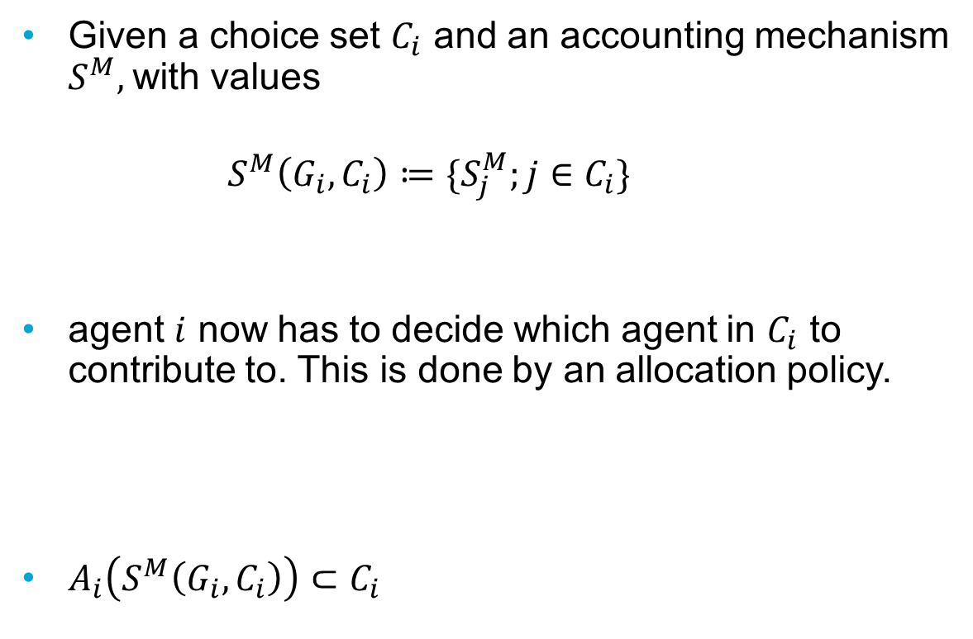
Allocation Policy
Given a choice set $C_{i}$ and an accounting mechanism $S^{M},$with values
$$S^{M}\left(G_{i},C_{i}\right)≔\{S_{j}^{M};j∈C_{i}\}$$
agent $i$ now has to decide which agent in $C_{i}$ to contribute to. This is done by an allocation policy.
$A_{i}\left(S^{M}\left(G_{i},C_{i}\right)\right)⊂C_{i}$

Slide 17
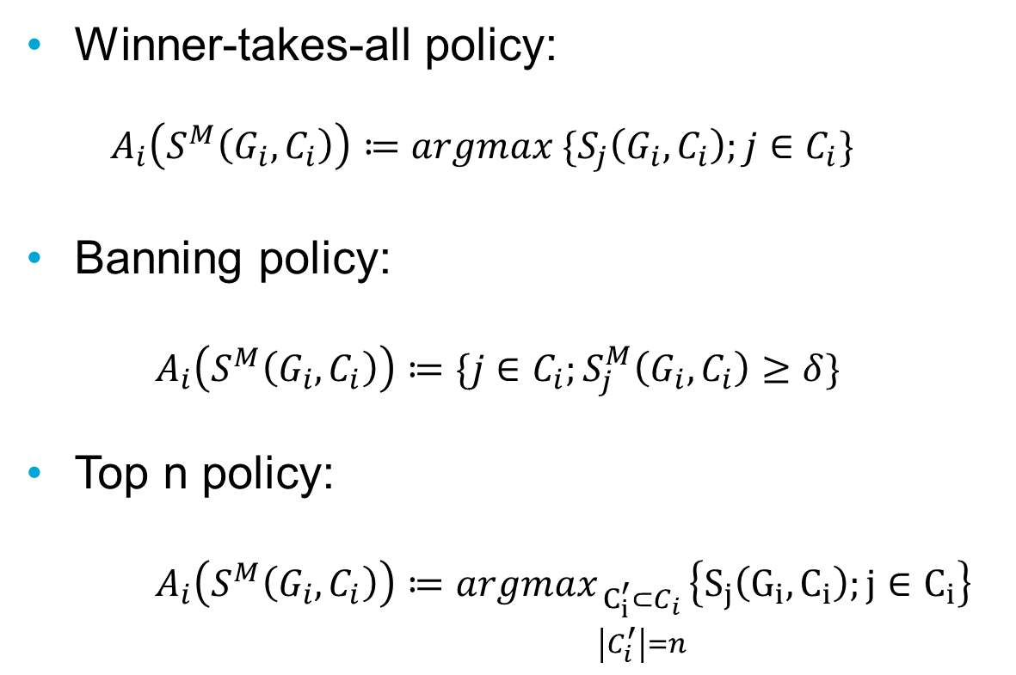
Allocation Policy Examples
Winner-takes-all policy:
$$A_{i}\left(S^{M}\left(G_{i},C_{i}\right)\right)≔argmax \{S_{j}\left(G_{i},C_{i}\right);j∈C_{i}\}$$
Banning policy:
$$A_{i}\left(S^{M}\left(G_{i},C_{i}\right)\right)≔\{j∈C_{i};S_{j}^{M}\left(G_{i},C_{i}\right)≥δ\}$$
Top n policy:
$$A_{i}\left(S^{M}\left(G_{i},C_{i}\right)\right)≔argmax_{\begin{aligned}C_{i}^{′}⊂C_{i} \\ \left|C_{i}^{′}\right|=n\end{aligned}}\left\{S_{j}\left(G_{i},C_{i}\right);j∈C_{i}\right\}$$

Slide 18
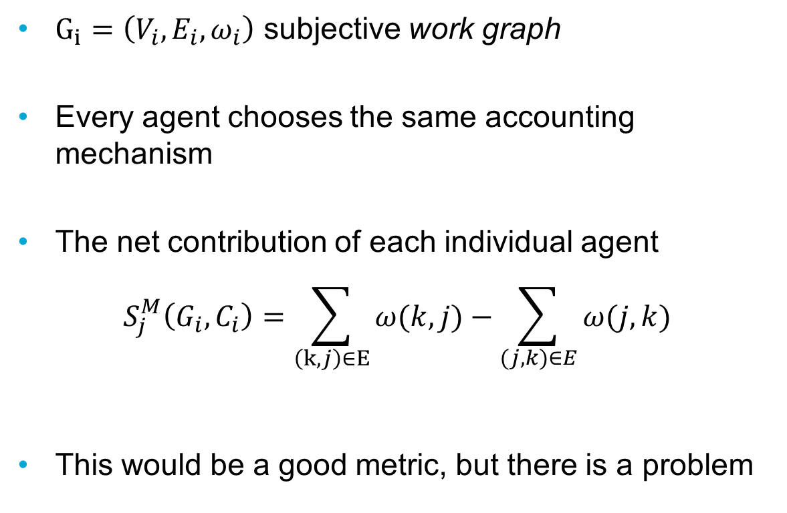
A trivial approach
$G_{i}=\left(V_{i},E_{i},ω_{i}\right)$ subjective work graph
Every agent chooses the same accounting mechanism
The net contribution of each individual agent
$$S_{j}^{M}\left(G_{i},C_{i}\right)=\sum_{\begin{aligned}\left(k,j\right)∈E \\ \end{aligned}}{ω(k,j)}−\sum_{(j,k)∈E}{ω(j,k)}$$
This would be a good metric, but there is a problem

Slide 19
Non-unique Identities
Assumption: Identities are not unique. A user can create as many accounts as they like at a relatively small cost
This leads to:
Whitewashing Attacks
Sybil Attacks

Slide 20
Sybil Attacks
A user can create large numbers of fake accounts
Sybil nodes can create fake edges between one another
Reported edge weights can no longer be trusted, except for those connected to the seed node itself
The trivial accounting mechanism is no longer valid
This is the primary problem distributed accounting mechanisms face

Slide 21
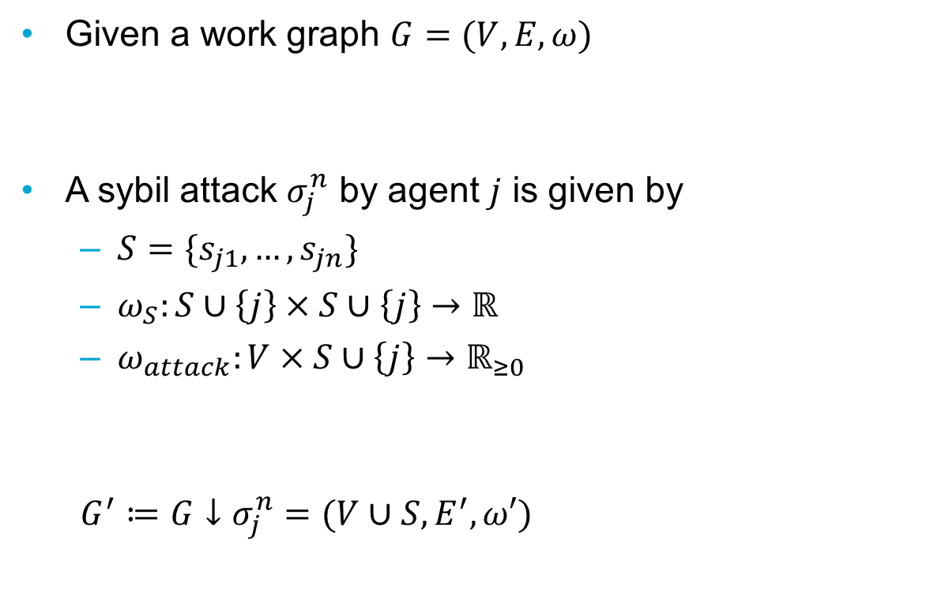
Classifying Sybil Attacks
Given a work graph $G=(V,E,ω)$
A sybil attack $σ_{j}^{n}$ by agent $j$ is given by
$S=\{s_{j1},…,s_{jn}\}$
$ω_{S}:S∪\left\{j\right\}×S∪\left\{j\right\}→ℝ$
$ω_{attack}:V×S∪\left\{j\right\}→ℝ_{≥0}$
$G^{′}≔G↓σ_{j}^{n}=(V∪S,E^{′},ω′)$

Slide 22
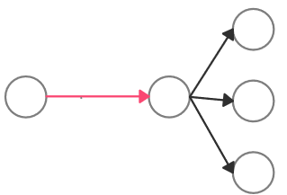
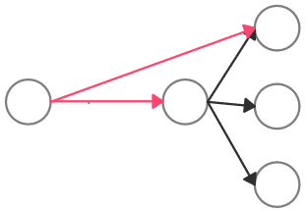
Active & Passive Sybil Attacks
Passive Attack
Active Attack
j
j

Slide 23
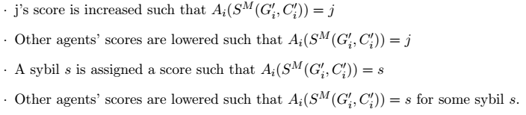
Sybil Attack Profit
An attack is beneficial if one of the 4 conditions is satisfied
We want to quantify this further by defining a profit function

Slide 24

Sybil Attack Profit
Cost of a sybil attack:
$$ω_{−}^{n}≔\sum_{v∈S∪\{j\}}{\sum_{u∈V}{ω(v,u)}}$$
Return of a sybil attack:
$$ω_{+}^{n}≔\sum_{i∈V^{′}\backslash \{j,s_{j1},…,s_{jn}\}}{\sum_{s∈\left\{j,s_{j1},…s_{jn}\right\}}{S_{s}^{M}\left(G_{i}^{′},C_{i}^{′}\right)}}$$

Slide 25
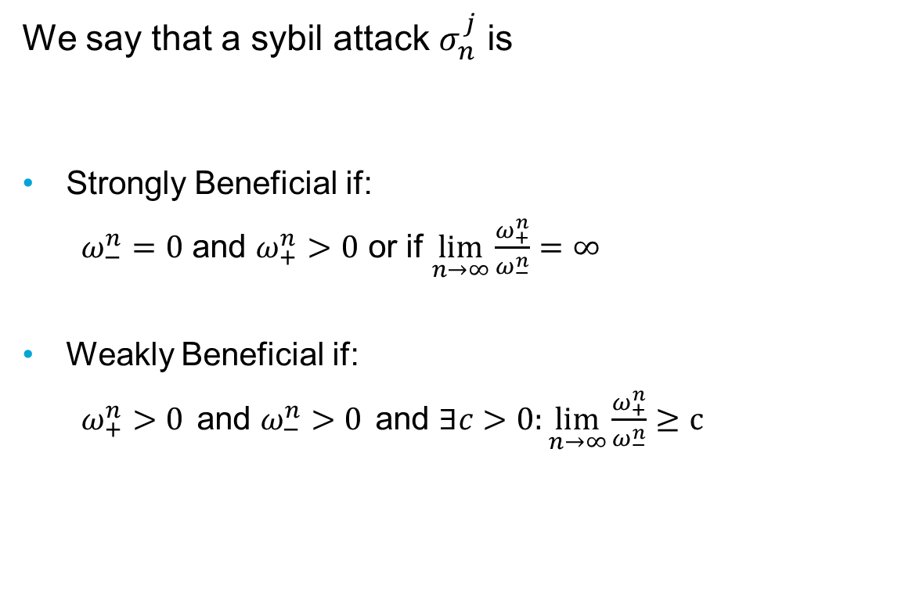
Sybil Attack Profit
We say that a sybil attack $σ_{n}^{j}$ is
Strongly Beneficial if:
$ω_{−}^{n}=0$ and $ω_{+}^{n}>0$ or if $\lim_{n→∞}\frac{ω_{+}^{n}}{ω_{−}^{n}}=∞$
Weakly Beneficial if:
$ω_{+}^{n}>0$ and $ω_{−}^{n}>0$ and $∃c>0:\lim_{n→∞}\frac{ω_{+}^{n}}{ω_{−}^{n}}≥c$

Slide 26
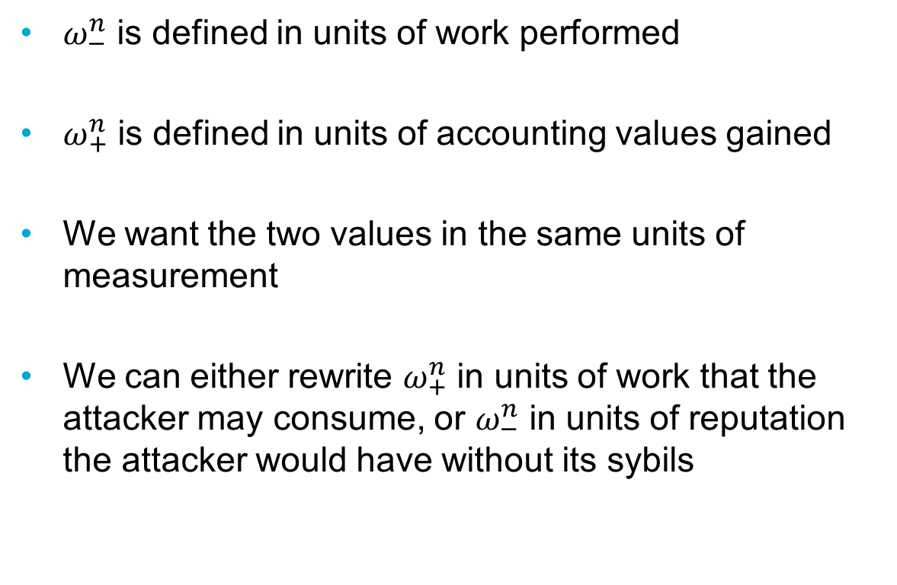

Making $ω_{+}^{n}$ and $ω_{−}^{n}$ comparable
$ω_{−}^{n}$ is defined in units of work performed
$ω_{+}^{n}$ is defined in units of accounting values gained
We want the two values in the same units of measurement
We can either rewrite $ω_{+}^{n}$ in units of work that the attacker may consume, or $ω_{−}^{n}$ in units of reputation the attacker would have without its sybils

Slide 27
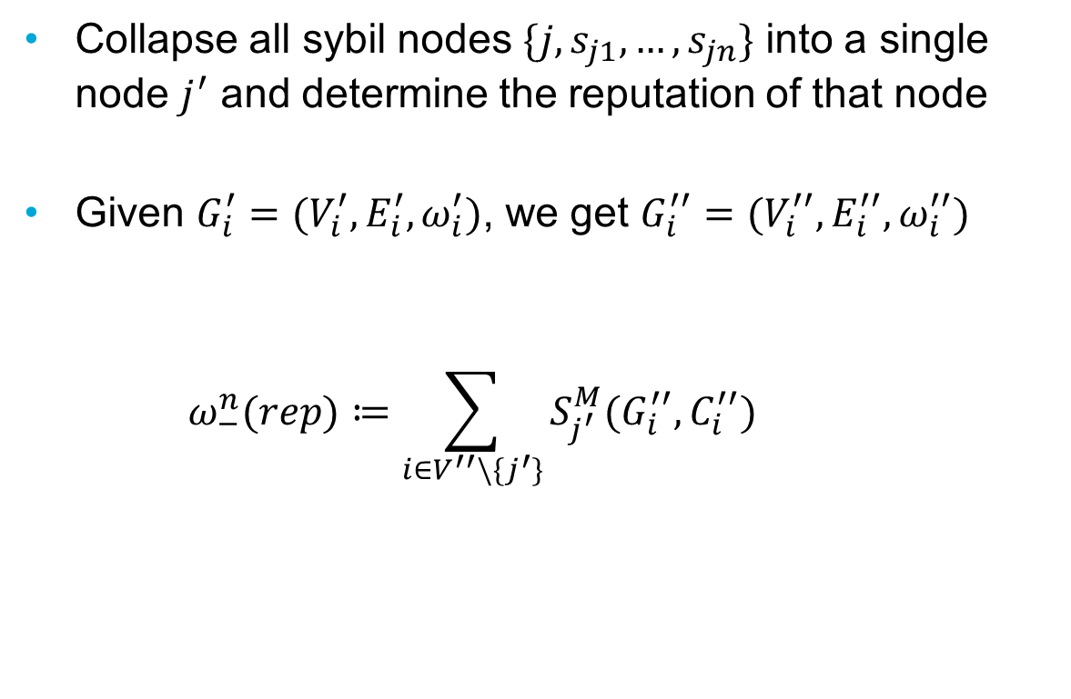
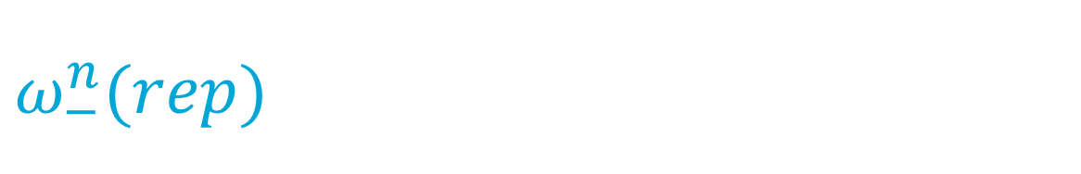
$$ω_{−}^{n}(rep)$$
Collapse all sybil nodes $\{j,s_{j1},…,s_{jn}\}$ into a single node $j^{′}$ and determine the reputation of that node
Given $G_{i}^{′}=(V_{i}^{′},E_{i}^{′},ω_{i}^{′})$, we get $G_{i}^{′′}=(V_{i}^{′′},E_{i}^{′′},ω_{i}^{′′})$
$$ω_{−}^{n}(rep)≔\sum_{i∈V^{′′}\backslash \{j^{′}\}}{S_{j^{′}}^{M}(G_{i}^{′′},C_{i}^{′′})}$$

Slide 28
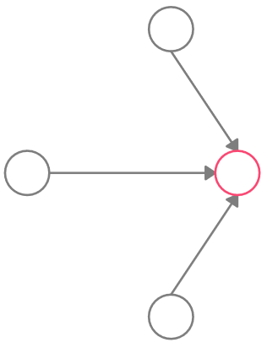
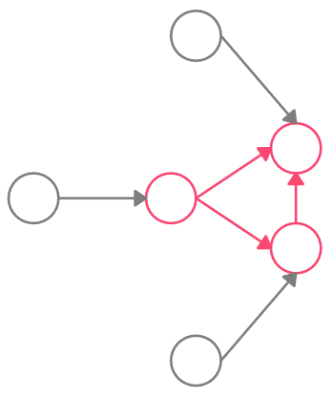


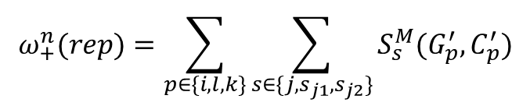



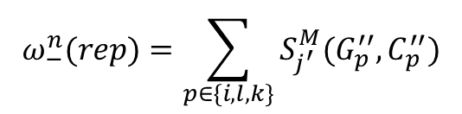








$$G_{i}^{′}$$
$$G_{i}^{′′}$$
$$k$$
$$k$$
$$s_{j1}$$
$$i$$
$$j$$
$$⟹$$
$$i$$
$$j$$
$$s_{j2}$$
$$l$$
$$l$$
$$ω_{+}^{n}(rep)=\sum_{p∈\{i,l,k\}}{\sum_{s∈\{j,s_{j1},s_{j2}\}}{S_{s}^{M}(G_{p}^{′},C_{p}^{′})}}$$
$$ω_{−}^{n}(rep)=\sum_{p∈\{i,l,k\}}{S_{j^{′}}^{M}(G_{p}^{′′},C_{p}^{′′})}$$

Slide 29
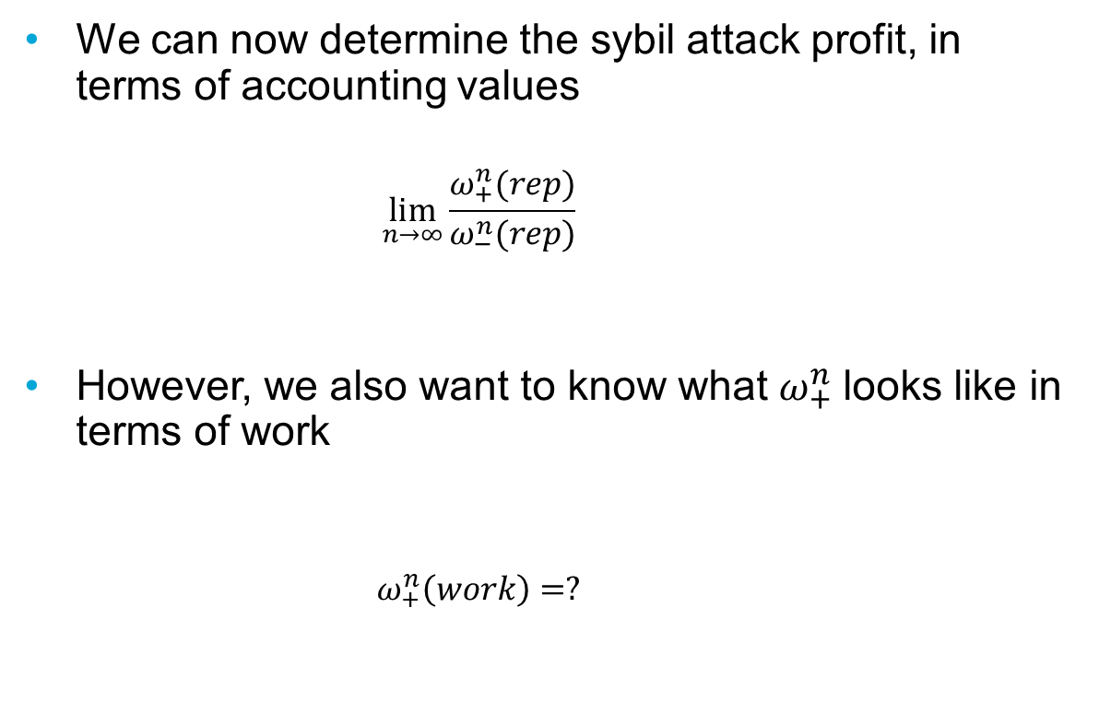
Sybil Attack Profit
We can now determine the sybil attack profit, in terms of accounting values
$$\lim_{n→∞}\frac{ω_{+}^{n}(rep)}{ω_{−}^{n}(rep)}$$
However, we also want to know what $ω_{+}^{n}$looks like in terms of work
$$ω_{+}^{n}\left(work\right)=?$$

Slide 30
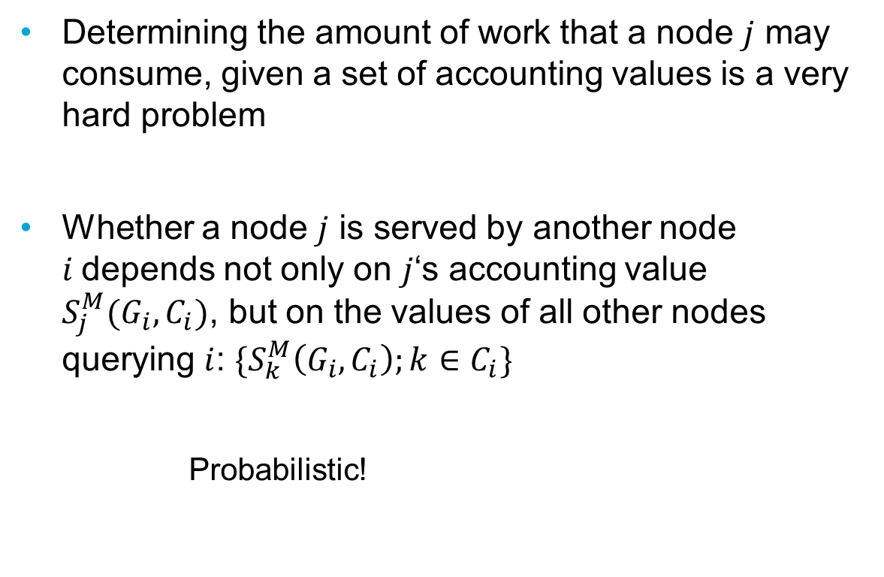

Determining $ω_{+}^{n}\left(work\right)$
Determining the amount of work that a node $j$ may consume, given a set of accounting values is a very hard problem
Whether a node $j$ is served by another node $i$depends not only on $j$‘s accounting value $S_{j}^{M}(G_{i},C_{i})$, but on the values of all other nodes querying $i$: $\{S_{k}^{M}\left(G_{i},C_{i}\right);k∈C_{i}\}$
Probabilistic!

Slide 31
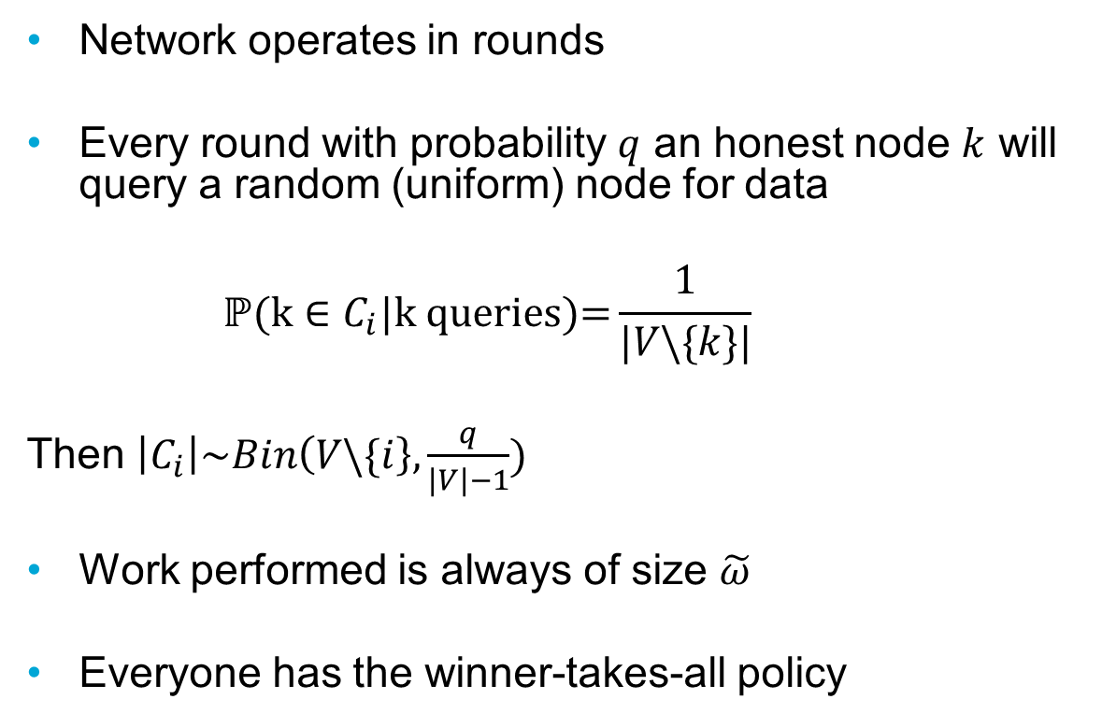

Assumptions for $ω_{+}^{n}\left(work\right)$
Network operates in rounds
Every round with probability $q$ an honest node $k$ will query a random (uniform) node for data
$$\text{ℙ}\text{(}\text{k}∈C_{i}\text{|}\text{k} \text{queries}\text{)=}\frac{1}{|V\backslash \{k\}|}$$
Then $\left|C_{i}\right|\sim Bin\left(V\backslash \{i\right\},\frac{q}{\left|V\right|−1})$
Work performed is always of size $\tilde{ω}$
Everyone has the winner-takes-all policy

Slide 32
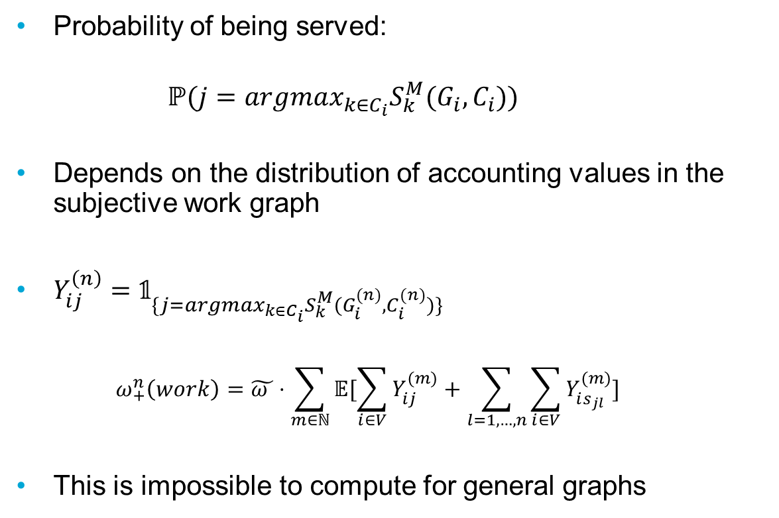
Assumptions for $ω_{+}^{n}\left(work\right)$
Probability of being served:
$$ℙ(j=argmax_{k∈C_{i}}S_{k}^{M}(G_{i},C_{i}))$$
Depends on the distribution of accounting values in the subjective work graph
$Y_{ij}^{\left(n\right)}=𝟙_{\{j=argmax_{k∈C_{i}}S_{k}^{M}(G_{i}^{(n)},C_{i}^{(n)})\}}$
$$ω_{+}^{n}\left(work\right)=\tilde{ω }⋅\sum_{m∈ℕ}{𝔼[\sum_{i∈V}{Y_{ij}^{(m)}+\sum_{l=1,…,n}{\sum_{i∈V}{Y_{is_{jl}}^{(m)}}}}]}$$
This is impossible to compute for general graphs

Slide 33
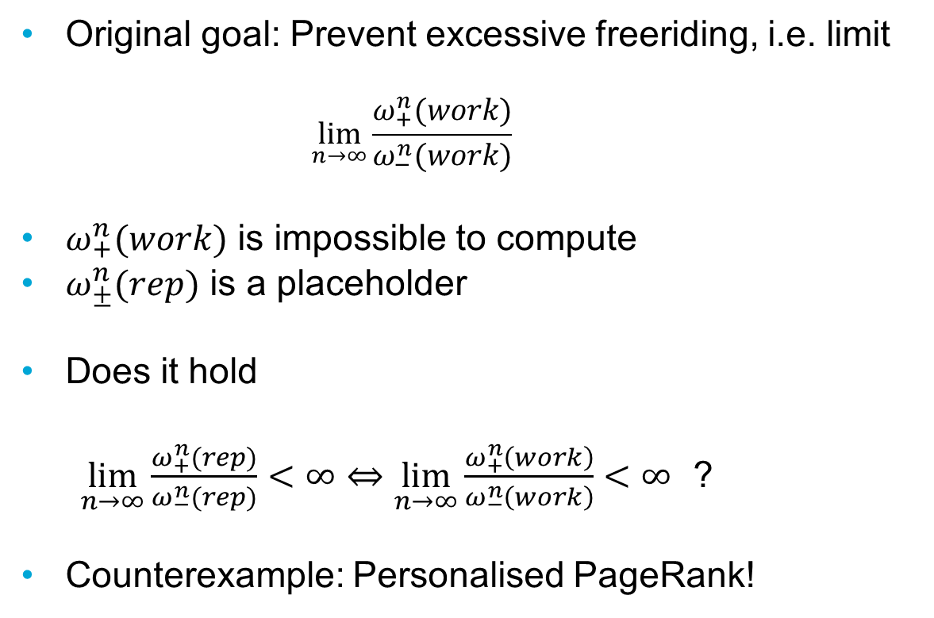
Question
Original goal: Prevent excessive freeriding, i.e. limit
$$\lim_{n→∞}\frac{ω_{+}^{n}(work)}{ω_{−}^{n}(work)}$$
$ω_{+}^{n}(work)$ is impossible to compute
$ω_{±}^{n}(rep)$ is a placeholder
Does it hold
$\lim_{n→∞}\frac{ω_{+}^{n}(rep)}{ω_{−}^{n}(rep)}<∞⇔\lim_{n→∞}\frac{ω_{+}^{n}\left(work\right)}{ω_{−}^{n}\left(work\right)}<∞$ ?
Counterexample: Personalised PageRank!

Slide 34
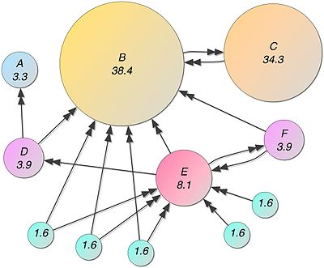
The PageRank Algorithm
Designed to rank webpages based on their importance
Importance Reputability

Slide 35

Mathematics of PageRank
PageRank is recursively determined by
with

Slide 36
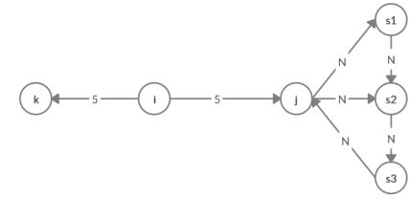
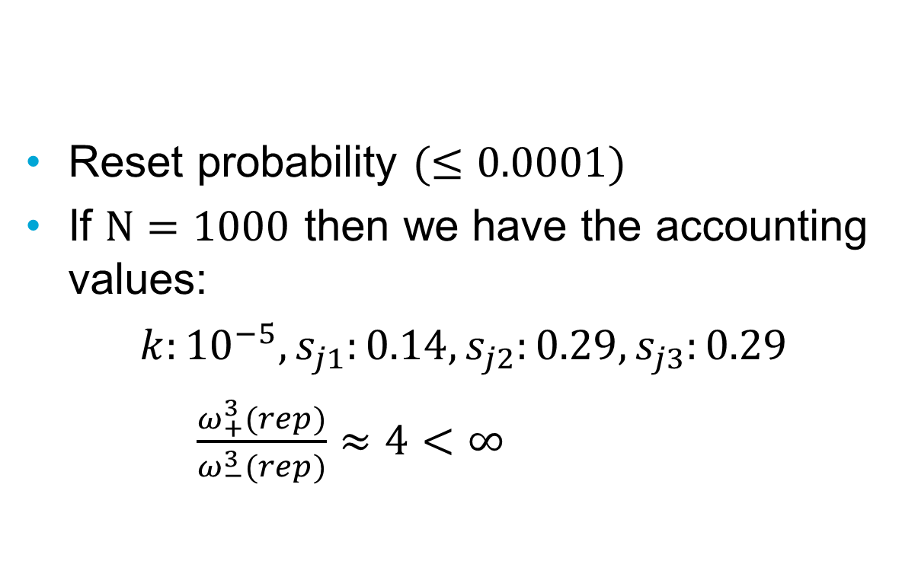
Reset probability $(≤0.0001)$
If $N=1000$ then we have the accounting values:
$k:{10}^{−5}, s_{j1}:0.14, s_{j2}:0.29, s_{j3}:0.29$
$\frac{ω_{+}^{3}(rep)}{ω_{−}^{3}(rep)}≈4<∞$

Slide 37
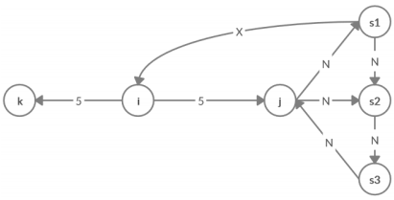
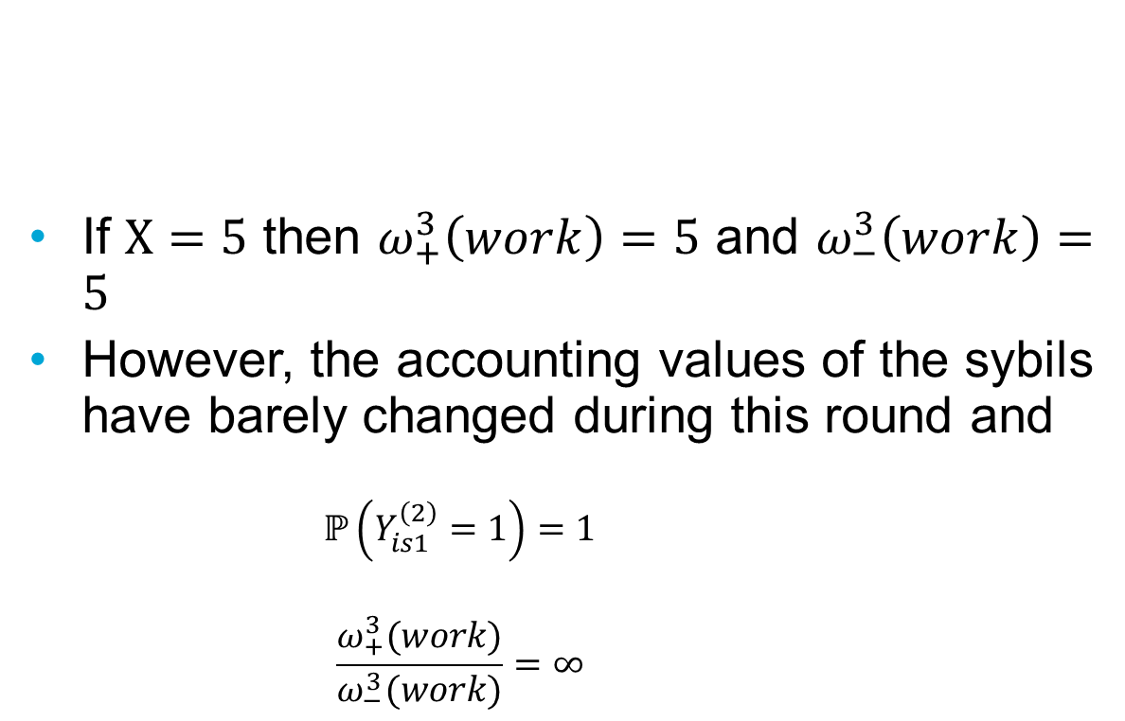
If $X=5$ then $ω_{+}^{3}\left(work\right)=5$ and $ω_{−}^{3}\left(work\right)=5$
However, the accounting values of the sybils have barely changed during this round and
$$ℙ\left(Y_{is1}^{\left(2\right)}=1\right)=1$$
$$\frac{ω_{+}^{3}(work)}{ω_{−}^{3}(work)}=∞$$

Slide 38
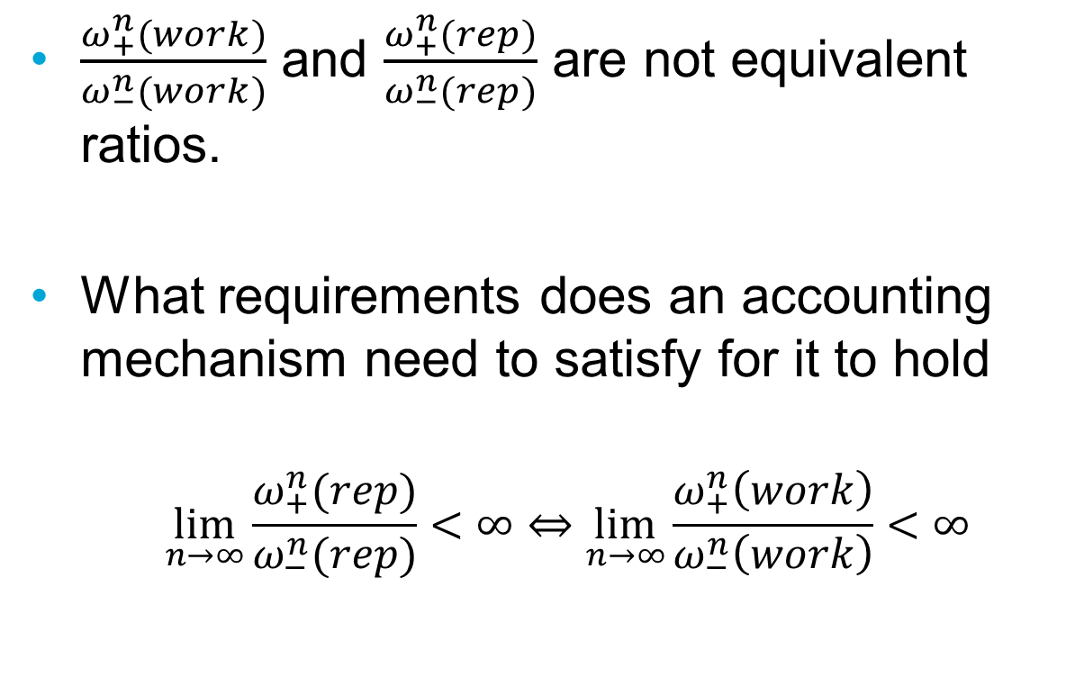
Open Question
$\frac{ω_{+}^{n}(work)}{ω_{−}^{n}(work)}$ and $\frac{ω_{+}^{n}(rep)}{ω_{−}^{n}(rep)}$ are not equivalent ratios.
What requirements does an accounting mechanism need to satisfy for it to hold
$$\lim_{n→∞}\frac{ω_{+}^{n}(rep)}{ω_{−}^{n}(rep)}<∞⇔\lim_{n→∞}\frac{ω_{+}^{n}\left(work\right)}{ω_{−}^{n}\left(work\right)}<∞$$

